Slide 1
TECHNOLOGY ADDICTION

Slide 2
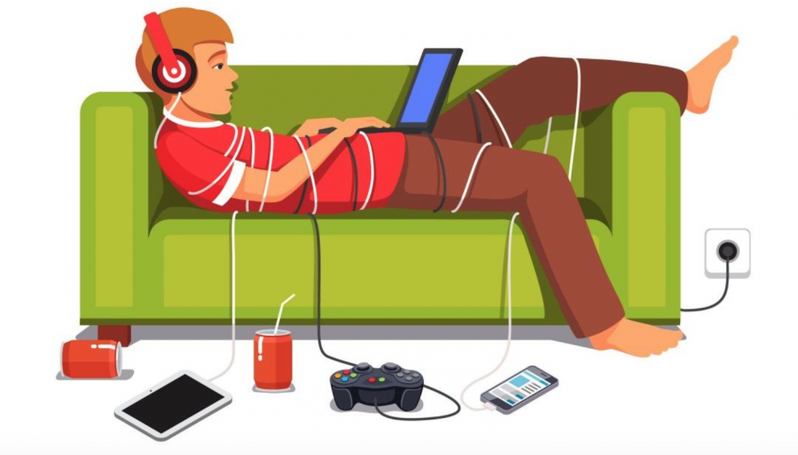
What is technology addiction?
frequent and obsessive technology-related behavior
compulsive computer use
obsessive use of mobile devices, the internet or video games
impulse control disorder

Slide 3
What makes technology addictive?
quick and easy way to fill basic needs
it can be a boredom buster
contains enormous amount of information
"Fear of Missing Out"
video games allow players to feel that they are good at something
makes the maintaining of human connection easier

Slide 4
promoting a sense of autonomy
actual recognition
a social lubricant
an escape from reality
allows an easier way of communication
requires few energy for a relatively big sens of entertaiment

Slide 5
What are the risks of teen technology use?
give students a false sense of relational security
encourages an unhealthy desire for instant gratification
slow internet connection or “unplugging” can promote irritability and anxiety
thanks to sleep disorder academic, athletic, and social performance can suffer
weight gain and other complications of a poor diet and sedentary lifestyle

Slide 6
Ways to Control Your Internet Addiction:
Block out distracting websites for a set amount of time.
Limit your attention to a single application at a time.
Create a distraction-free environment for writing.
Instantly block the social websites that are killing your focus.
Remind yourself to take regular breaks to keep your focus sharp.

Slide 7
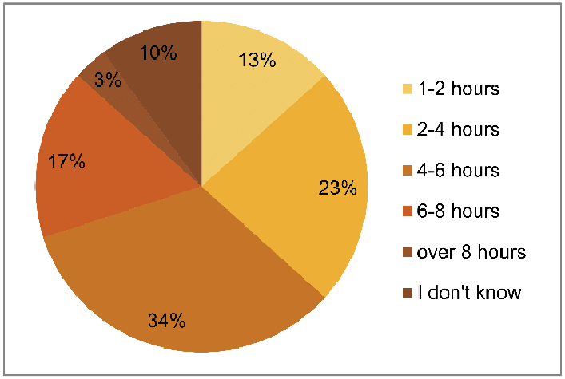
The length of time students spend on internet:

Slide 8
Create a healthy balance:
control your technology use
protect your eyes
seat in a proper position in front of computer
prevent any sort of addiction
convey your children the necessary information

Slide 9
Thank you for your attention!

