Slide 1
Technology addiction

Slide 2
Technology addiction
This is a project that we made for the Erasmus agency. This is about technology addiction made by an international group:
From Spain: Lucas Alonso, Raquel Pascual Sebastiàn
From Slovenia: Tjaša Pintar
From Romania: Ambarus-Egyed András
From Hungary: Tóth Zoltán
From Italy: Federica Del Mastro, Marta Natilii, Anna Di Paolo, Lucia Notarnicola

Slide 3
What is technology addiction?
Technology addiction refers to the uncontrollable urge or impulse to continue using technology to the point that it starts to interfere with the individual’s mental, physical, and social life. This can be in forms of social media, internet surfing, video games, online gambling, and other related acts.

Slide 4
THE MOST COMMON TYPES OF TECHNOLOGY ADDICTION:
Gaming addiction:
Gaming has become more popular than ever before and are available not only on consoles and computers but also right on your phone. Part of what makes gaming so addictive are built in rewards, hidden features, and side quests.
Every time an individual completes a level, beats a boss, kills an opponent, or unlocks a new player or level the individual receives a boost of dopamine, resulting in gaming-induced pleasure.
Some games are never ending.
Socially interactive games such as eSports have also become increasingly popular. Such games may be more socially engaging than one-player games but can also lead to a false sense of social interaction.

Slide 5
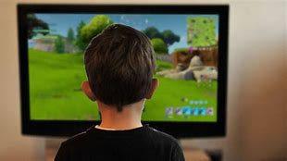

Slide 6
2. Social Media addiction
Social media platforms such as TikTok, Instagram, Snapchat and others are highly addictive, and YouTube can also be grouped into this category.
Every time an individual receives engagement via a “like,” “follow” or “comment” the individual’s brain releases feel-good neurotransmitters, ultimately resulting in wanting more engagement.
Social media, like social gaming, can invoke a false sense of social engagement leaving individuals feeling isolated and alone.

Slide 7
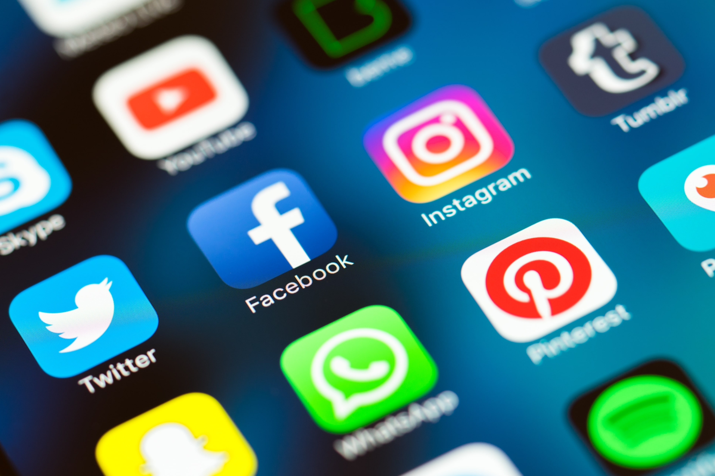

Slide 8
Doomscrolling
Endless scrolling of social media feeds, constantly refreshing feeds or binge watching TikTok or YouTube videos also serve as a way to fend of loneliness, fight off boredom and fill other psychological voids. Doomscrolling and a fear of missing out also play a large part in social media addiction.

Slide 9
Other types of technology addiction
3. Online gambling addiction
4. Pornography addiction
5. Online Shopping
6. Work-Related Digital addiction

Slide 10
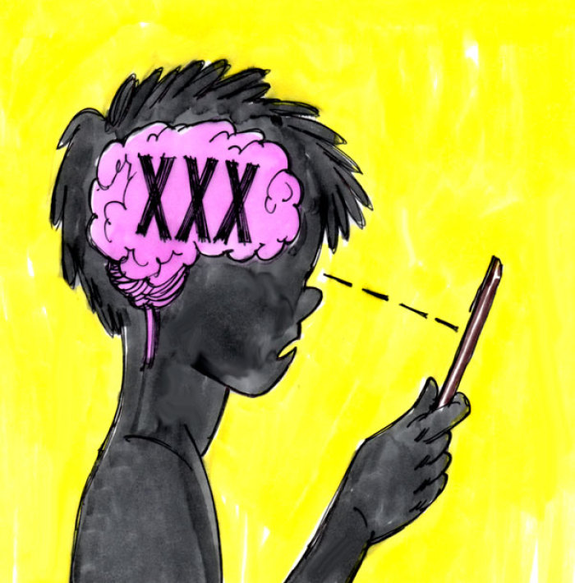

Slide 11
Signs of technology addiction:
Neglecting important life areas such as work, school or relationships at the expense of technology.
Using digital devices in dangerous situations such as while driving a car or walking across a city street. Experiencing unwanted mental health symptoms such as depression, anxiety, stress or irritability at the expense of technological usage.
Lying or hiding digital usage from family, friends or colleagues as a result of guilt or shame.
Using digital devices for longer durations than intended or finding yourself using digital devices with increased frequency over time.

Slide 13
Treatment for curing this addictions
The first step of treating a digital addiction is the individual’s awareness of the problem, and a desire to want to get help. This is often the most challenging step for the individual.
For those that may need to seek professional help from an addiction therapist there are different modalities of treatment available for technology addictions.

Slide 14
If the individual is motivated the issue can resolve itself with self-corrective behaviors, screen-life balance, and assistance from technological innovations that help with digital moderation such as by enabling app restrictions or WiFi restrictions, turning off notifications, enabling “Do Not Disturb” mode, setting up automatic email/text responses, enabling automatic downtime, blocking apps or websites, using screen time reports, and other such innovations that can help curb digital use.

