Slide 1
H.E.A.L.T.H.
Help Everyone Achieve Lifelong Total Health

Slide 3
9:30 – Welcoming guests in the school’s Festivity Room
10:00 – School presentation guided by the vice-principal (EN)
11:00 – Ice breaker, Forming work groups, School presentation by vice-principal (HUN/teachers*)
11:30 – Distributing tasks
12:00 – The drama Troy performed by students in the Festivity Room
13:00 – Free time with host families Suggestion: Organ concert in Saint Michael’s Church at 19:00
20:00 – Dinner for the teachers at Boema House

Slide 5






Sweet potato | Eggplant | Avocado | Broccoli | Tomato | Carrot
Benedikti Anna | Böröndy Kata | Németh Viola Panna | Deme Lola | Luxl Sára | Molnár Márk
Matteo Colleluori | Scarpone Francesca | Cardona Gonzales Iris | Di Paolo Anna | Aleks Grum Orešnik | Miha Zafošnik
Stržinar Nika | Demšar Manca | Friškovec Kumar Sara | Žiga Režek | Piccari Rosita | Mancebo Laguna Laura
Csidei Boglárka | Reynés Fernández Gema | Ferencz Péter | Rodríguez Pérez Álvaro | Lopez Gomez Antonio | Cantarini Alessia
Akerman Ágota | Török-Schuller Lilla | Békési Rebeka | Nagy Eszter | Ambarus Egyed Andris | Hegedűs Éva
Pálfi Hanga | Baki Tímea | Tamás Kriszta | Dénezsi Ágoston | Jánosi Dücskő Antónia | Horváth Tamás
Pascual Sebastián Raquel | Venczel Hanna | Linares Carfagnini Rodrigo A. | Kun Szabolcs Nimród | Tánczos Dorottya | Juhász Kincső
 | Laping Dávid |  | Szabó Boglárka |  | Pápai Anita

Slide 6
The six groups are challenged to complete the following tasks within the course of this week, having at their disposal 50 lei. Each group will purchase ingredients and cook the dish according to the instructions they picked. By the end of the week, each group must present their work to the teachers!
You must buy ingredients on your own!
Prepare the dish!
Film the process of preparation (the video must not be longer than 2 mins.)
Measure the amount of calories of the dish!
Taste it! XD

Slide 7
!!!!! FOR THE CITY TOUR YOU NEED TO BRING A PENDRIVE AND A LAPTOP TOO !!!!!

Slide 8
Tuesday:
9:30 – Meeting at the school’s Festivity Room
10:00 – Workshop: Creating different types of tasks
12:30 – Collecting and presenting tasks
13:00 – Free time
16:00-19:00 – City Tour for the students – Discover Cluj!
16:00 – Suggestion for teachers: Guided walk in the old town

Slide 9
Compose exercises considering a healthy diet taking examples
from the workbook! (solutions also attached!)

Slide 10
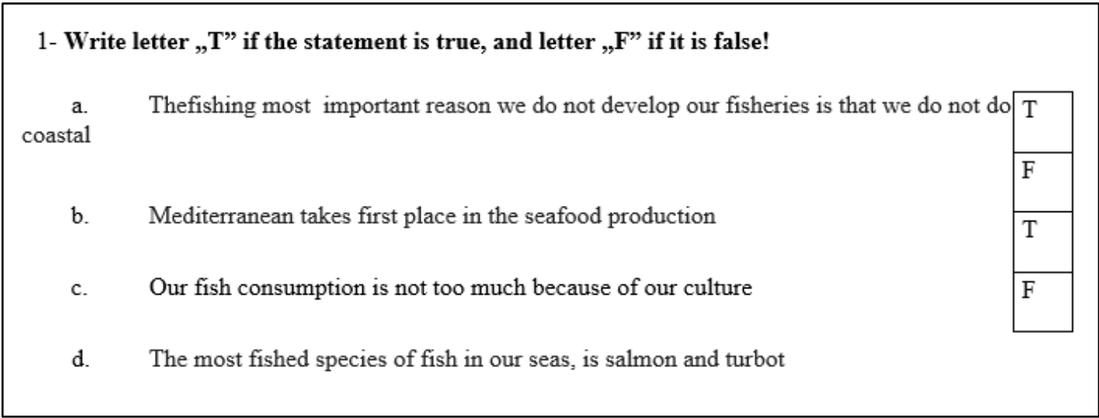

Slide 11
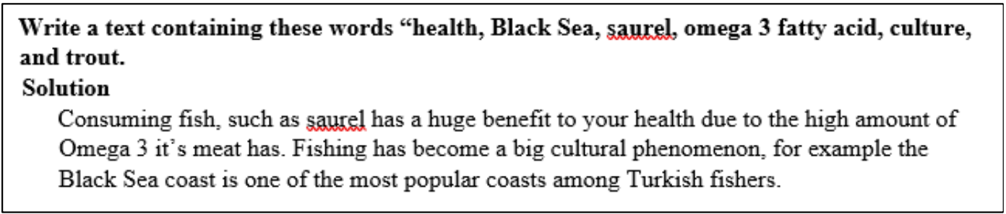

Slide 12


Slide 13
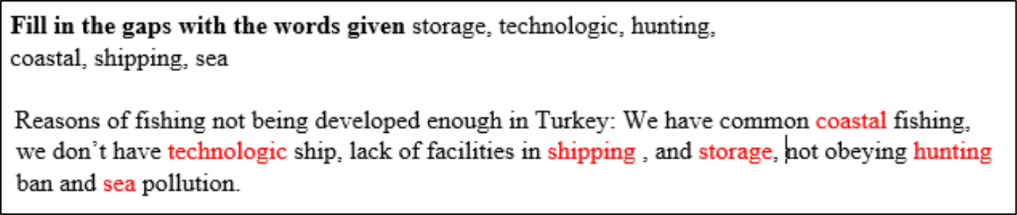

Slide 14
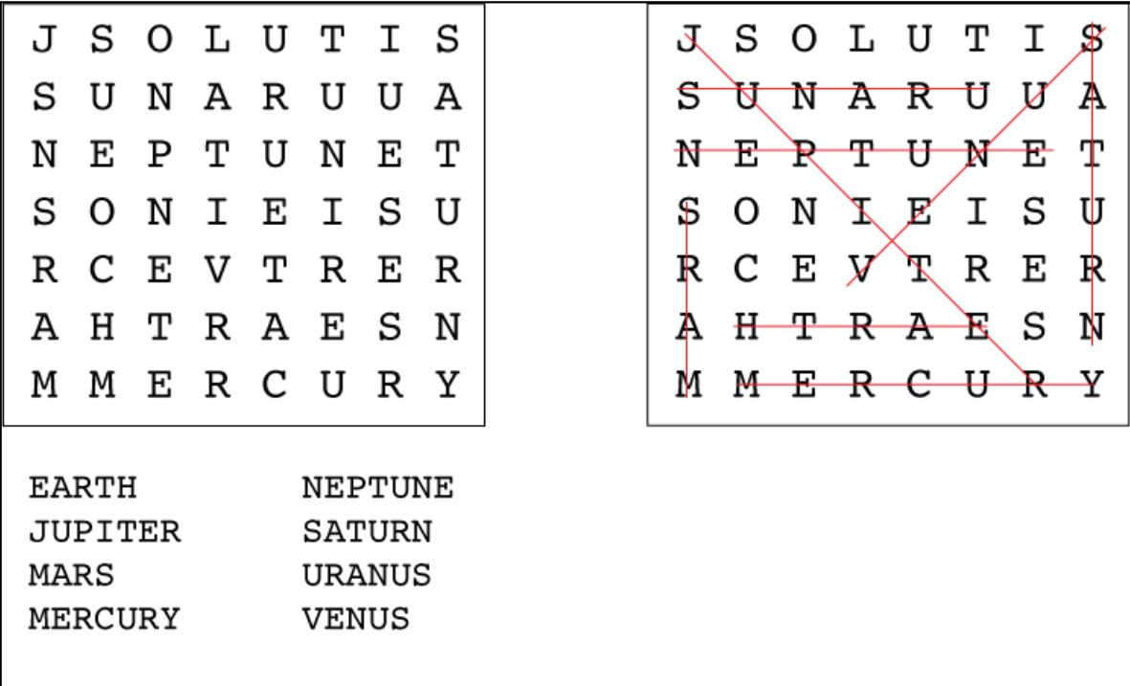

Slide 15
Wednesday:
9:30 – Meeting at the school’s Festivity Room
10:00 – Workshop on the movie: Our Daily Bread
14:00 – Free time Suggestion: Organ concert in the Reformed Church at 19:00

Slide 16
Workshop on the movie:
In this task each group will get a short fragment of the movie "Our Daily Bread". The short videos will be about 1,5 minutes long and each group has to write and perform a fitting narration. The groups should use their phones to do this task. Suggestion: The video should be played on the phone while it is being narrated and you should record the display with the microphone at the same time

Slide 17
1
2
3
4
5
6

Slide 18
!!!!! TOMORROW AT 7:45 WE’RE MEETING AT HÁZSONGÁRDI CEMETERY, BRING FOOD WITH YOU !!!!!

Slide 19
Thursday:
7:45 – Meeting at Házsongárdi Cemetery
Trip to: Salt Mine of Torda Torda Gorge Torockó Village
19:00 – traveling back to Cluj

Slide 20
Friday:
9:30 – Meeting at the school’s Festivity Room
10:00 – Presenting final work results in the Festivity Room
13:00 – Teacher’s meeting in the Teacher’s room
13:00 – Free time for students with host families
19:00 – Dinner for the teachers at Bistro 1568

