Slide 1
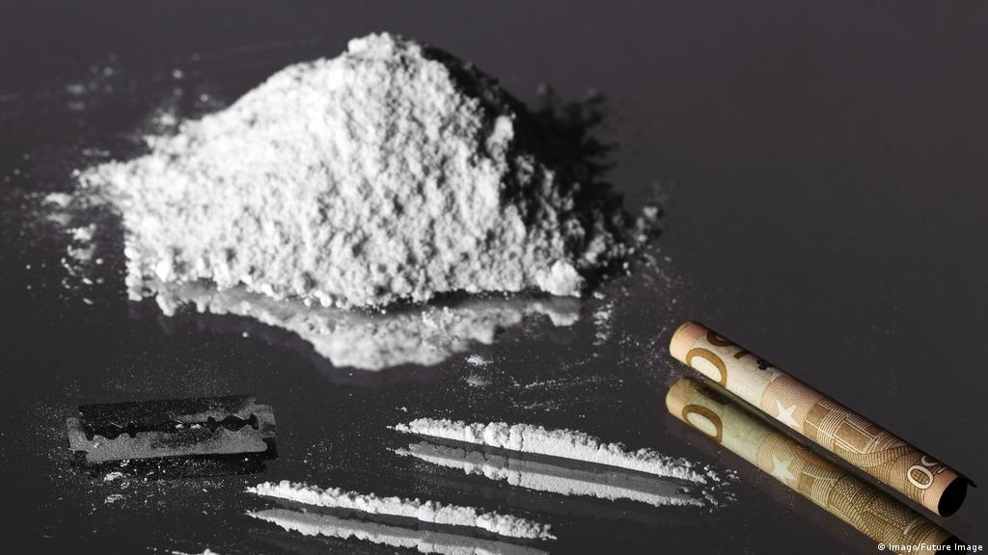
Addiction to hard drugs

Slide 2
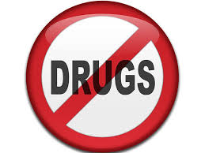
Overview
Drug addiction, is a disease that affects a person's brain and behavior and leads to an inability to control the use of a legal or illegal drug or medication. When you're addicted, you may continue using the drug despite the harm it causes.
Drug addiction can start with experimental use of a recreational drug in social situations, and, for some people, the drug use becomes more frequent.
The risk of addiction and how fast you become addicted varies by drug. Some drugs, such as opioid painkillers, have a higher risk and cause addiction more quickly than others.
As time passes, you may need larger doses of the drug to get high. Soon you may need the drug just to feel good. As your drug use increases, you may find that it's increasingly difficult to go without the drug. Attempts to stop drug use may cause intense cravings and make you feel physically ill
After you have got addicted to drugs, you may need other help to stay drugs-free

Slide 3
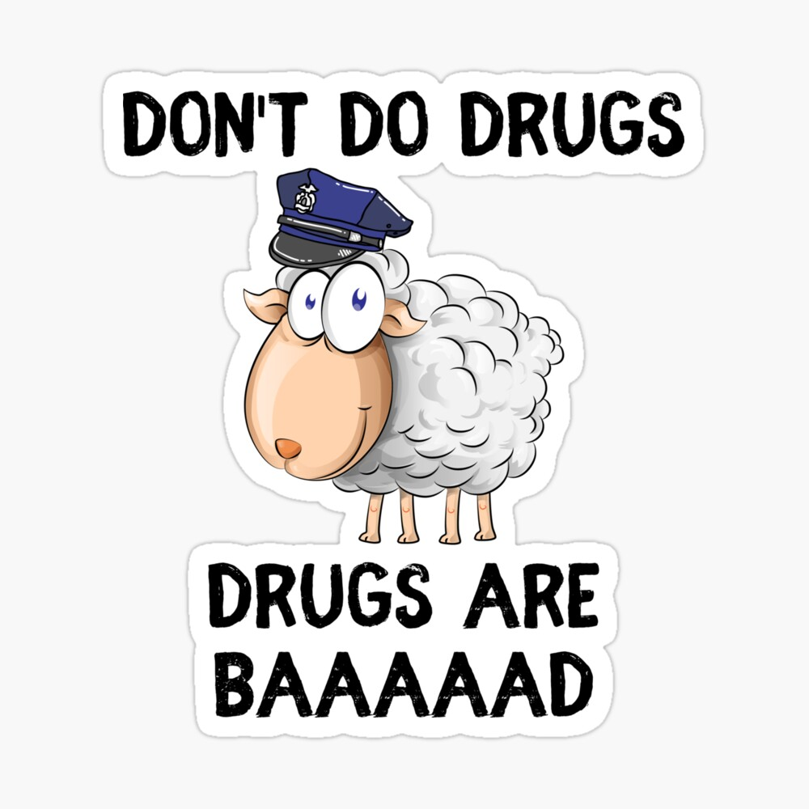
Symptoms
Drug addiction symptoms or behaviors include, among others:
You feel like you need to use the drugs regularly
Having intense urges for the drug that block out any other thoughts
After a while, you need to consume more and more to get the same effect as at beginning
You use the drug for a longer period of time, then you initially thought
You make sure that you own supplies of the drugs

Slide 4
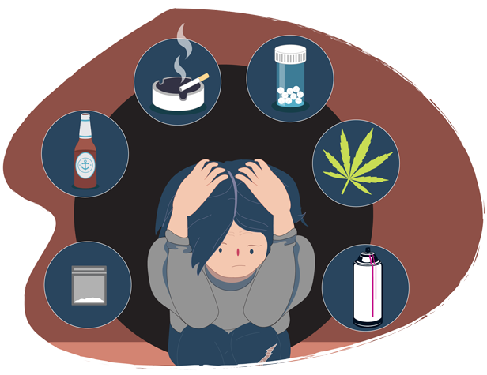
How to recognize unhealthy drug usage?
Sometimes it's difficult to distinguish normal teenage moodiness or angst from signs of drug use
a sudden drop at school or at work performance
lack of energy and motivation, weight loss or gain, or red eyes
The drug consumer doesn´t show sign of interest in how he is clothing or his or her appearance
Sudden change in behavior, become more aggressive
The consumer suddenly requests more and more money without any explanation

Slide 5
Effects
Unfortunately it doesn´t have any positive effects:
The most important one is that it ruins numerous families and relations
The consumer becomes more and more aggressive with anyone who wants to help them, because they think that they are doing the right things.
It weakens the immune system, which can cause other diseases which could be deadly

Slide 6
Information
Used websites:
https://www.mayoclinic.org/diseases-conditions/drug-addiction/symptoms-causes/syc-20365112
https://www.webmd.com/mental-health/addiction/drug-abuse-addiction#1
https://archives.drugabuse.gov/publications/media-guide/science-drug-use-addiction-basics

