Slide 1
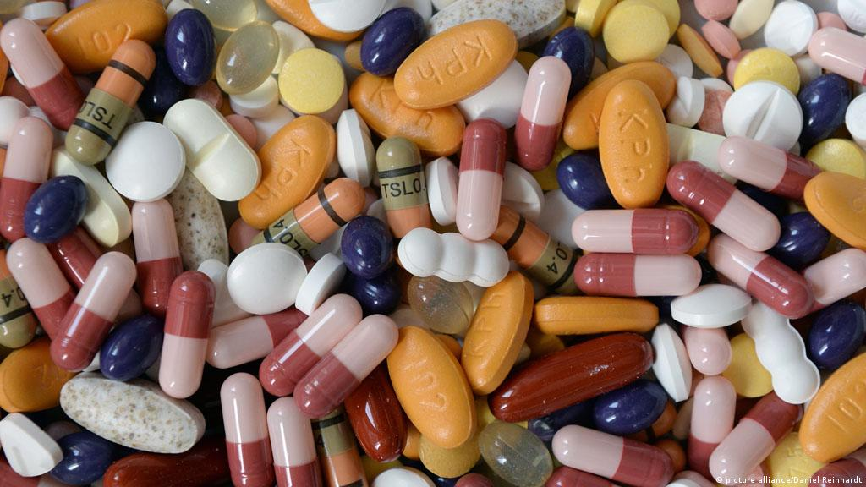
Addiction to medicines
Dallas Buyers Club

Slide 2
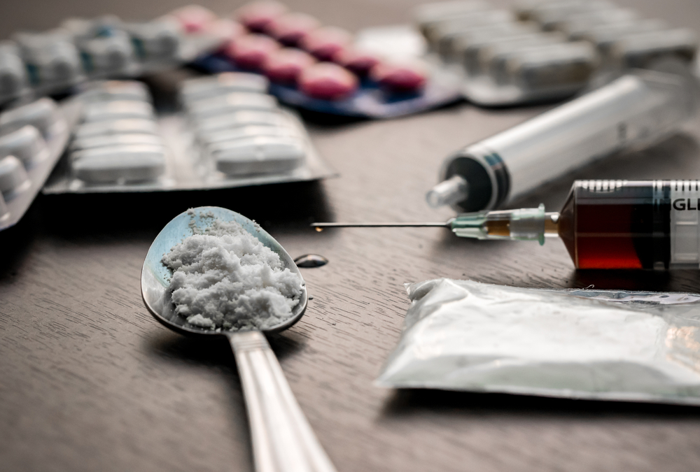
Reasons to take drugs
more fun
lose weight
fit in
study more effectively

Slide 3
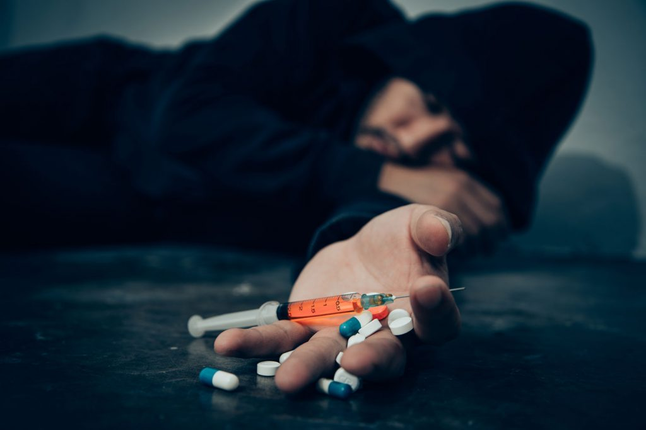
Prescription drugs can be easier to get than street drugs
Family members or friends may have them
Prescription drugs are also sometimes sold on the street like other illegal drugs.
In 2017, 1 in 7 teens surveyed said they have taken a prescription drug without a doctor's prescription.
Only safe for the people who have prescriptions for them. They also are aware of side effects and can watch patients closely for these.

Slide 4
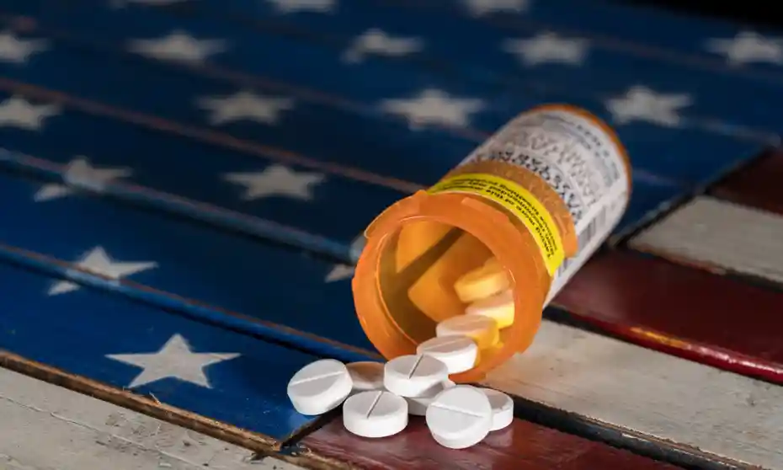
Which drugs are abused?
Opioids
Central Nervous System (CNS) Depressants
Stimulants

Slide 5
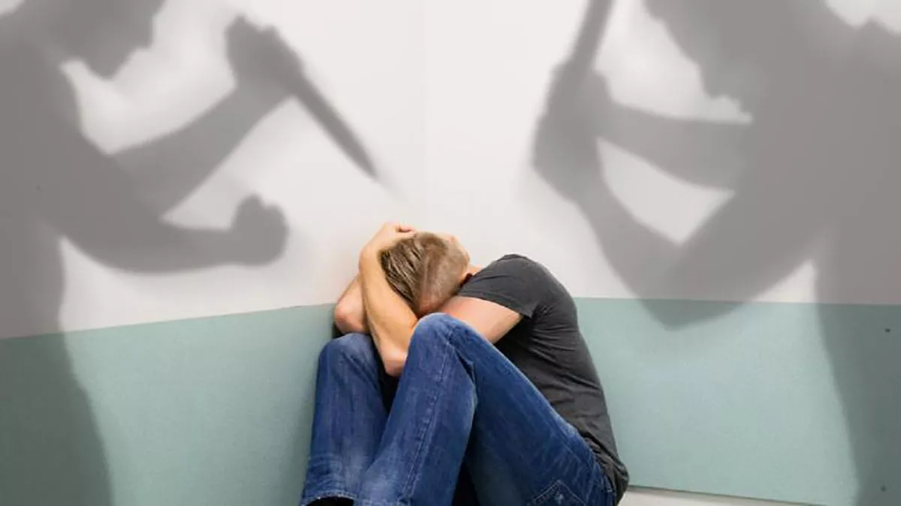
Dangers of abusing medicines
Opioid abuse:
vomiting
mood changes
decrease in ability to think
high risk of death
CNS depressant abuse:
abruptly stopping taking these can lead to seizures
taking CNS depressants with other medicines, such as prescription painkillers, some over-the-counter cold and allergy medicines, or alcohol can slow a person's heartbeat and breathing, and even kill
Stimulant abuse:
heart failure or seizures
dangerously high body temperature
irregular heartbeat
can lead to aggression and paranoia

Slide 6
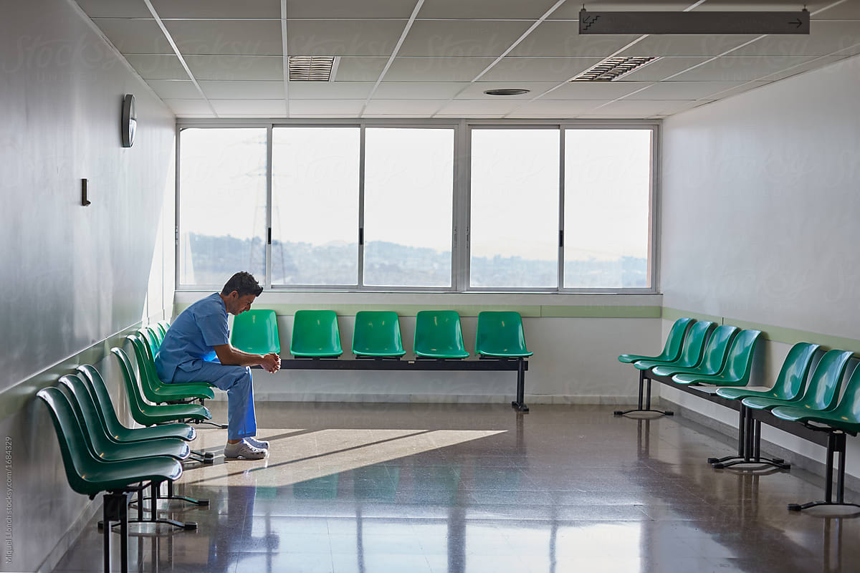
Tips for taking prescription medicines
Keep all doctor's appointments.
Make a note of the effects the drug has on your body and emotions tell your doctor about these.
Keep any information your pharmacist gives you
Never increase or decrease the dose of your medicine without checking with your doctor's office first

Slide 7
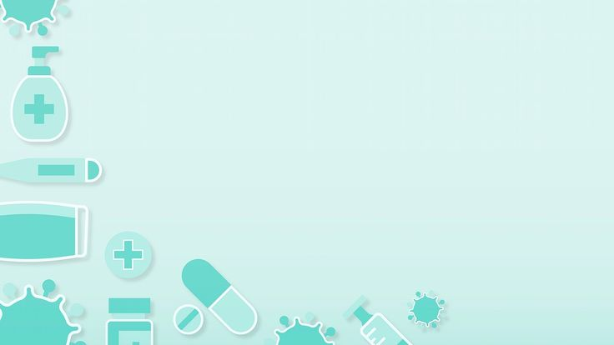
Thanks for your patience
Agoston Denezsi
Angelika Ambrus
Candela López
Lucija Zakelj
Sofía Garcia
Laura Zafra

