Slide 1
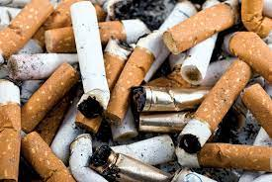
Addiction to tobacco and smoking
Group 4

Slide 2
Data
Tobacco kills more than 8 million people each year. More than 7 million of those deaths are the result of direct tobacco use while around 1.2 million are the result of non-smokers being exposed to secondhand smoke.
Over 80% of the world's tobacco users live in low- and middle-income countries.
In 2020, nearly 13 of every 100 U.S. adults were smoking cigarettes.
Approximately 30.8 million adults in the United States currently smoke cigarettes and more than 16 million Americans live with a smoking-related disease.

Slide 4
Causes
The addiction to tobacco is because of nicotine and other harmful substances.
Dopamine is released in the reward center of the brain and causes feelings of pleasure and improved mood.
The social cause of smoking it consists of people trying to relieve stress by making it a habit, it helps them relax, also it has a cultural meaning which was developed through history.

Slide 5
Solution
There should be alternatives of cigarettes, trying to focus on it being less harmful, for example:
Using other types of leaves instead of tobacco, with less nicotine
Using the method of heating instead of burning when smoking
Using degradable filters and packaging made from less environmentally harmful materials
Alternative types: Puff-Bars (not containing nicotine); hand-made cigarettes
Or just STOP SMOKING!

Slide 6
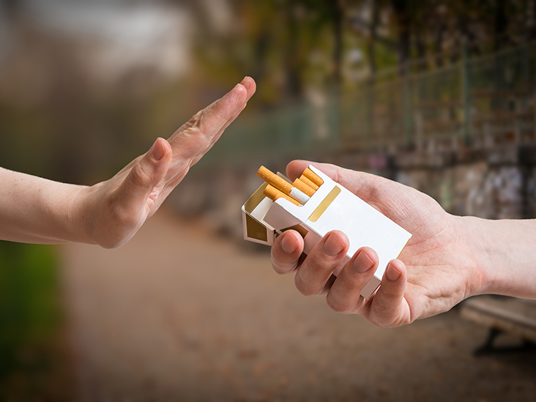

Slide 7
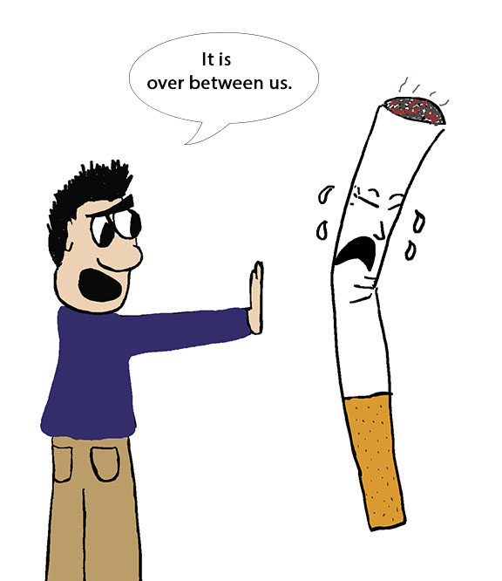
Internet resources
•https://en.wikipedia.org/wiki/Tobacco
•https://en.wikipedia.org/wiki/Tobacco_smoking

Slide 8
Thanks for Watching!

