Slide 1
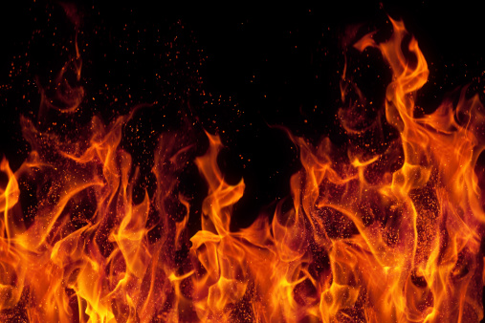
1st PROCEDURES IN CASE OF FIRE

Slide 2
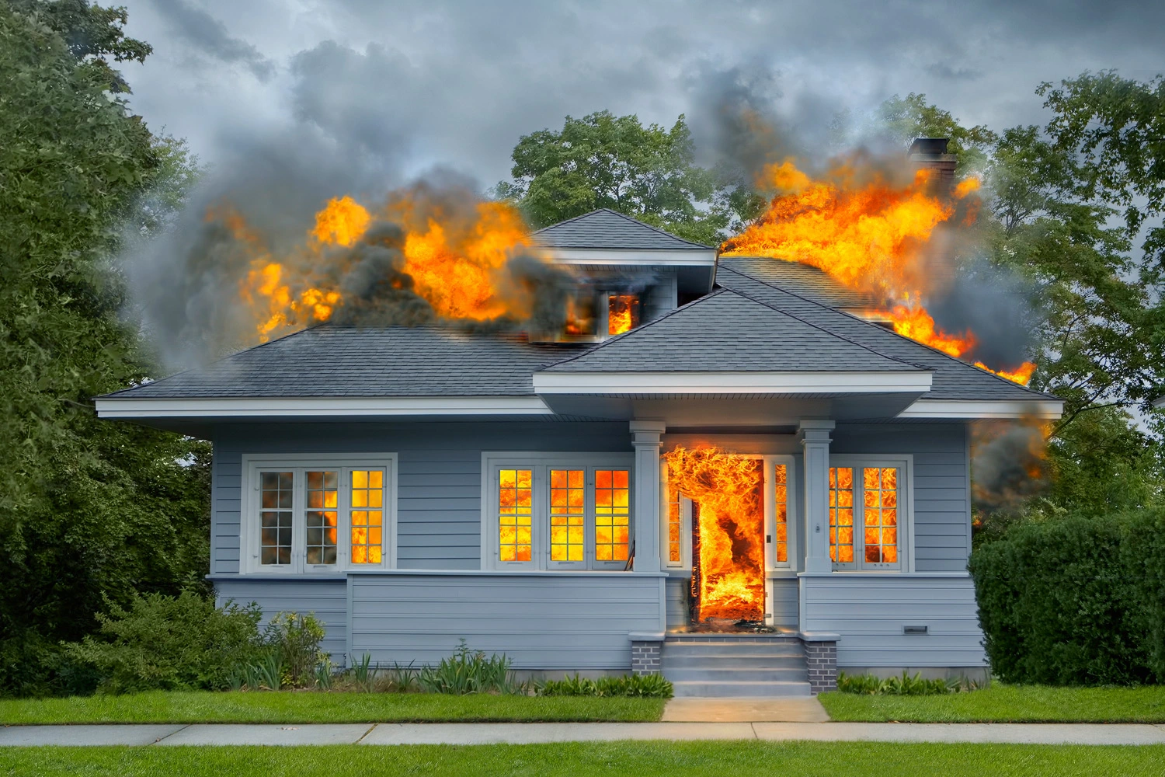
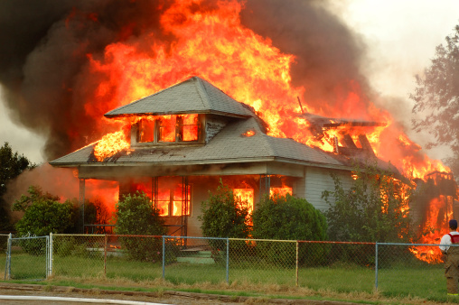
Steps in case of fire
If you notice a fire, notify the persons present in the danger zone.
Call the fire department on 112.
After dialing a fire brigade emergency number you should calmly and clearly state:
- your name and address, the telephone number that we are calling from
- address and name of the object on fire
- what is on fire and on which floor
- if there is a threat to human life or health.

Slide 3
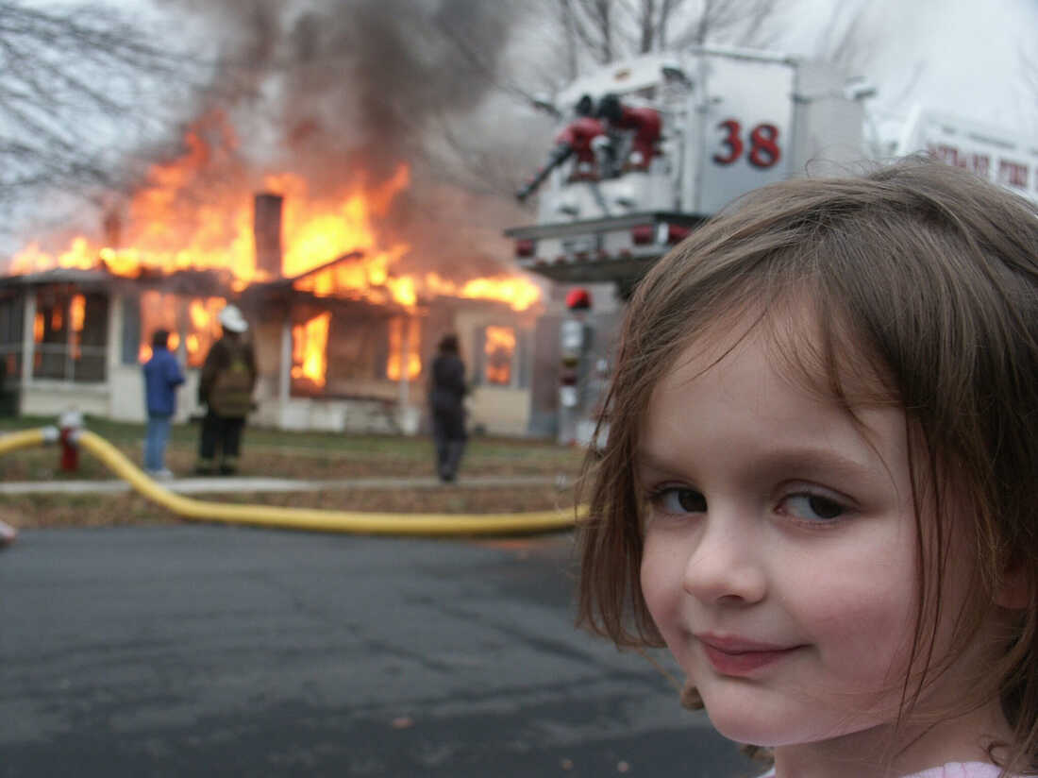
After the information is given to the duty officer at the fire department, do not hang up until the confirmation is given.
Upon arrival of firefighters you should strictly obey the instructions of the head of rescue and firefighting.
stay at home, closing the front door only with the doorknob.
turn off the gas valve, turn off all electric appliances,
in order to prevent the entering of smoke and high temperatures through the front door to
the apartment door openings and leaks must be protected e.g. with a wet towel,
call for help through an open window or balcony

Slide 4
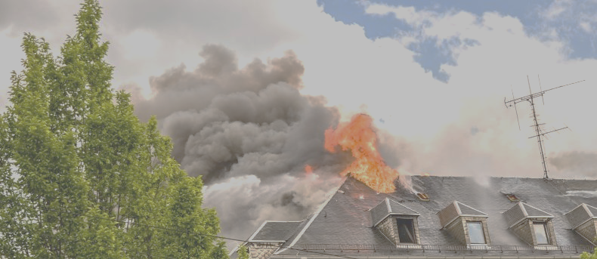
In the event of a fire in your apartment you should proceed as follows:
move out of the apartment children and people with disabilities,
If your way out of the apartment is cut off to go to the room farthest from the fire which has window or balcony, taking with you / if possible / wet blanket, closing the door to other rooms on the doorknob. Call out for help through the window or balcony, in case of strong smoke and rising temperatures lie down on the balcony under the window and cover tightly with a blanket or other covering.

Slide 5
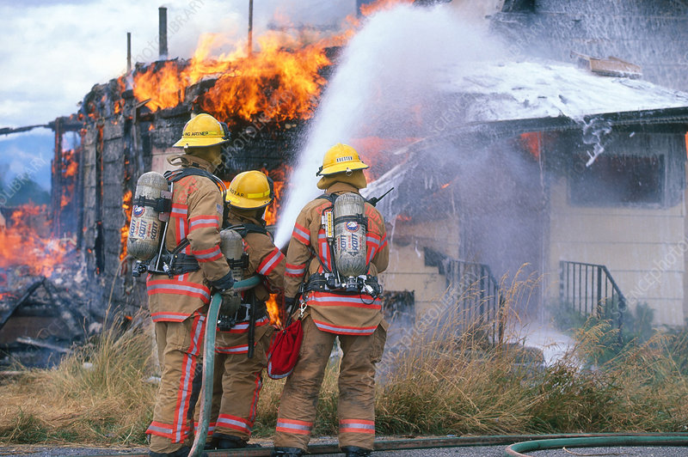
If putting out the fire on your own is impossible leave the apartment, closing the door only on the doorknob.
In the event of a fire in an apartment next door or on the lower floor and smoke on the corridor and stairway you should:
depending on the situation take extinguishing action, turn off the gas supply and electricity,do not open the windows
In case of fire on the upper floor you should remain in the apartment or leave it on the order of the person in charge of firefighting action, closing the front door to the apartment with a key.

