Slide 1
Injury prevention and safety behavior
group 3

Slide 2
Reducing risks

Slide 3
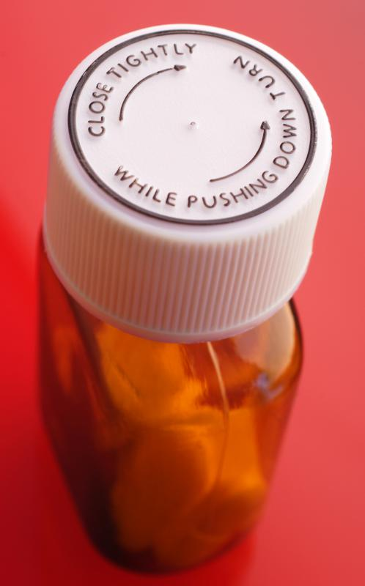
Proper and consistent use of safety equipment
helmets
gates
child-proof containers
latches
protector glasses

Slide 4
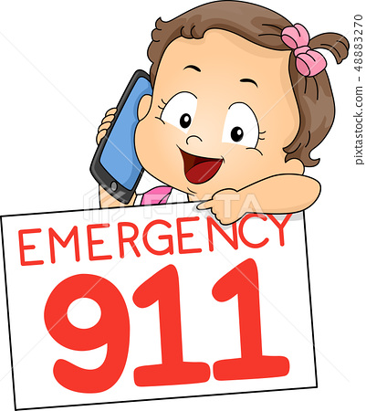
Conveying important informations
phone numbers
poison control
first aid
rules applied in traffic
medicine control
the location of defibrillator

Slide 5
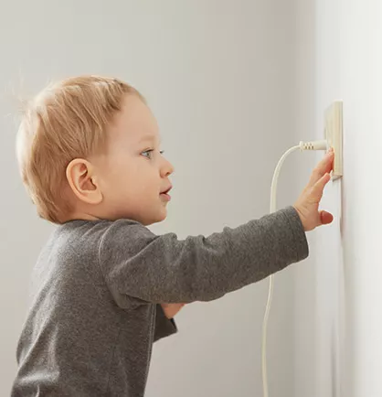
Supervise children activities
near water
near electricity
in the kitchen
near hazardous materials
near roads
in any kind of dangerous situations

Slide 6
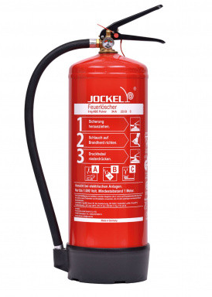
The installation and proper use of safety devices
smoke detector
powder extinguisher
gas detector
first aid box

