Slide 1
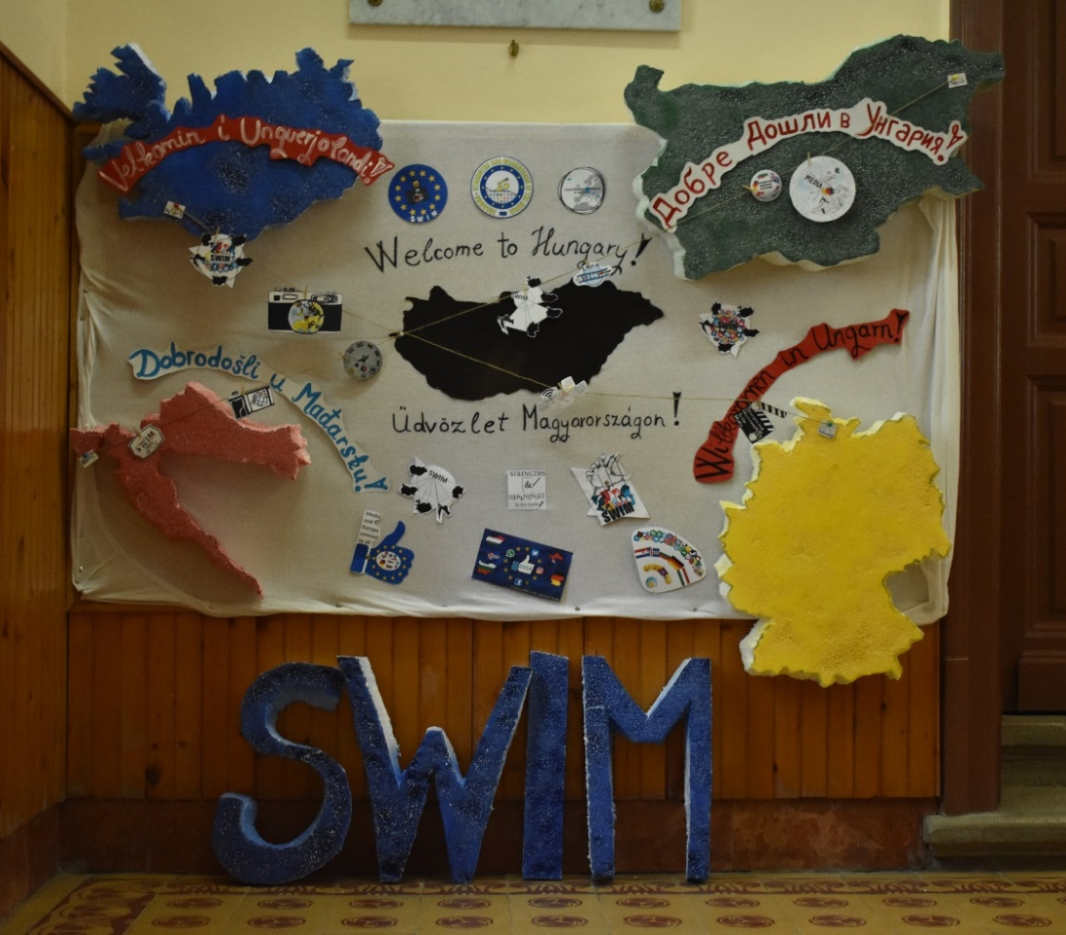
SWIM 2019

Slide 2
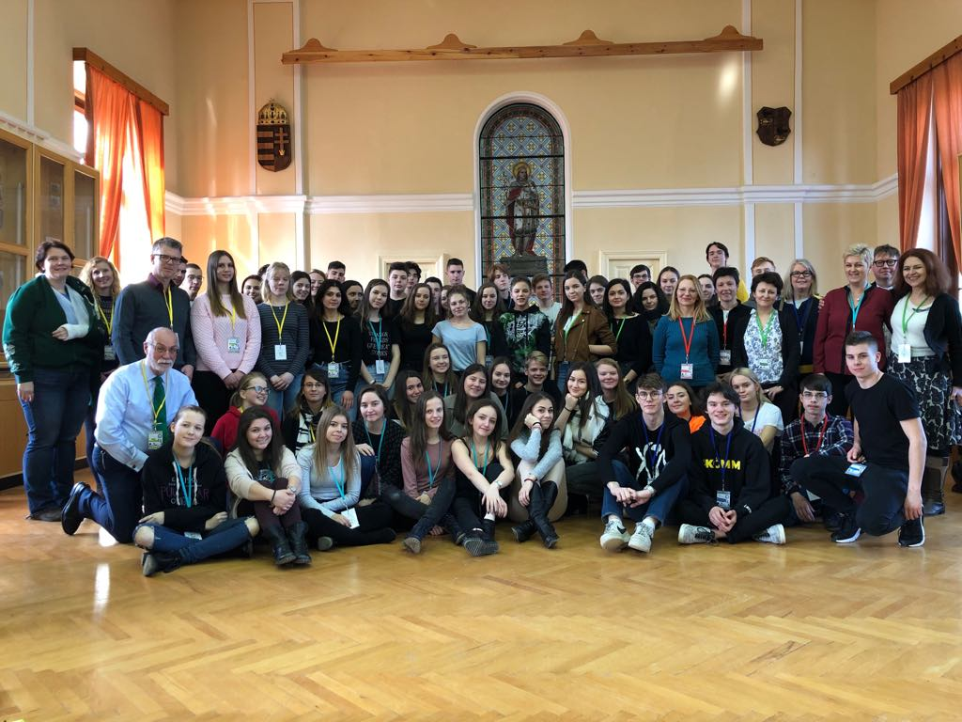
January
Monday | Tuesday | Wednesday | Thursday | Friday | Saturday | Sunday
31 | 1 | 2 | 3 | 4 | 5 | 6
7 | 8 | 9 | 10 | 11 | 12 | 13
14 | 15 | 16 | 17 | 18 | 19 | 20
21 | 22 | 23 | 24 | 25 | 26 | 27
28 | 29 | 30 | 31 | 1 | 2 | 3

Slide 3
February
Monday | Tuesday | Wednesday | Thursday | Friday | Saturday | Sunday
28 | 29 | 30 | 31 | 1 | 2 | 3
4 | 5 | 6 | 7 | 8 | 9 | 10
11 | 12 | 13 | 14 | 15 | 16 | 17
18 | 19 | 20 | 21 | 22 | 23 | 24
25 | 26 | 27 | 28 | 1 | 2 | 3

Slide 4
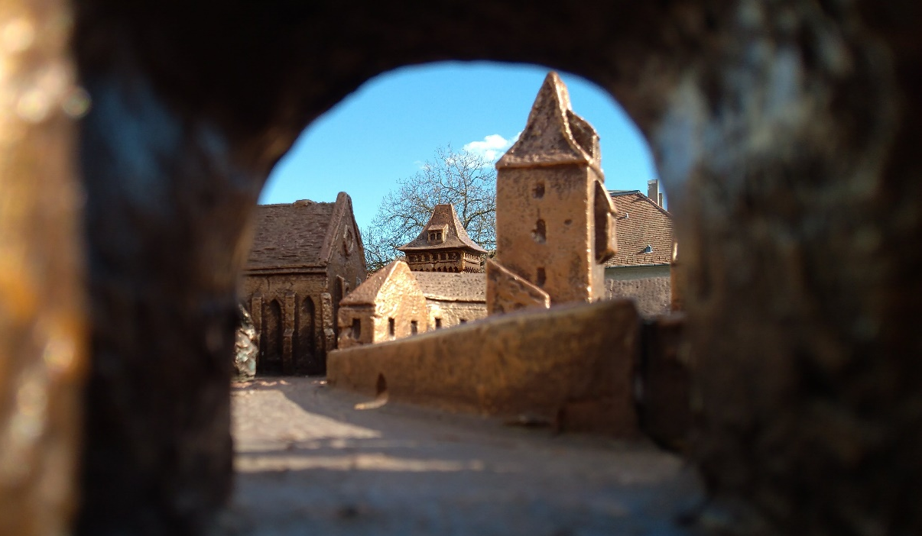
March
Monday | Tuesday | Wednesday | Thursday | Friday | Saturday | Sunday
25 | 26 | 27 | 28 | 1 | 2 | 3
4 | 5 | 6 | 7 | 8 | 9 | 10
11 | 12 | 13 | 14 | 15 | 16 | 17
18 | 19 | 20 | 21 | 22 | 23 | 24
25 | 26 | 27 | 28 | 29 | 30 | 31

Slide 5
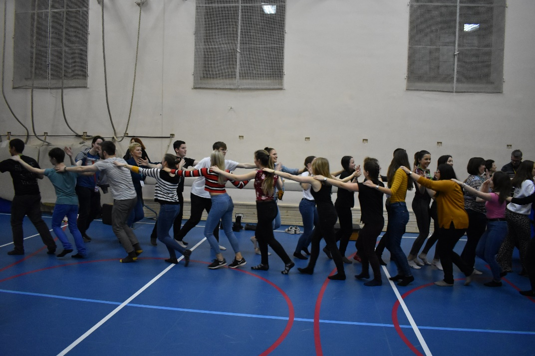
April
Monday | Tuesday | Wednesday | Thursday | Friday | Saturday | Sunday
1 | 2 | 3 | 4 | 5 | 6 | 7
8 | 9 | 10 | 11 | 12 | 13 | 14
15 | 16 | 17 | 18 | 19 | 20 | 21
22 | 23 | 24 | 25 | 26 | 27 | 28
29 | 30 | 1 | 2 | 3 | 4 | 5

Slide 6
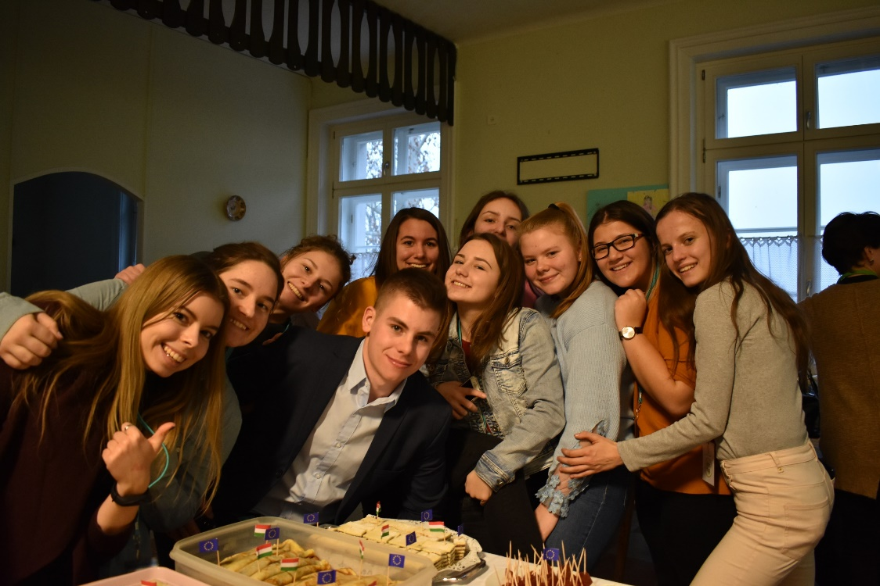
May
Monday | Tuesday | Wednesday | Thursday | Friday | Saturday | Sunday
29 | 30 | 1 | 2 | 3 | 4 | 5
6 | 7 | 8 | 9 | 10 | 11 | 12
13 | 14 | 15 | 16 | 17 | 18 | 19
20 | 21 | 22 | 23 | 24 | 25 | 26
27 | 28 | 29 | 30 | 31 | 1 | 2

Slide 7
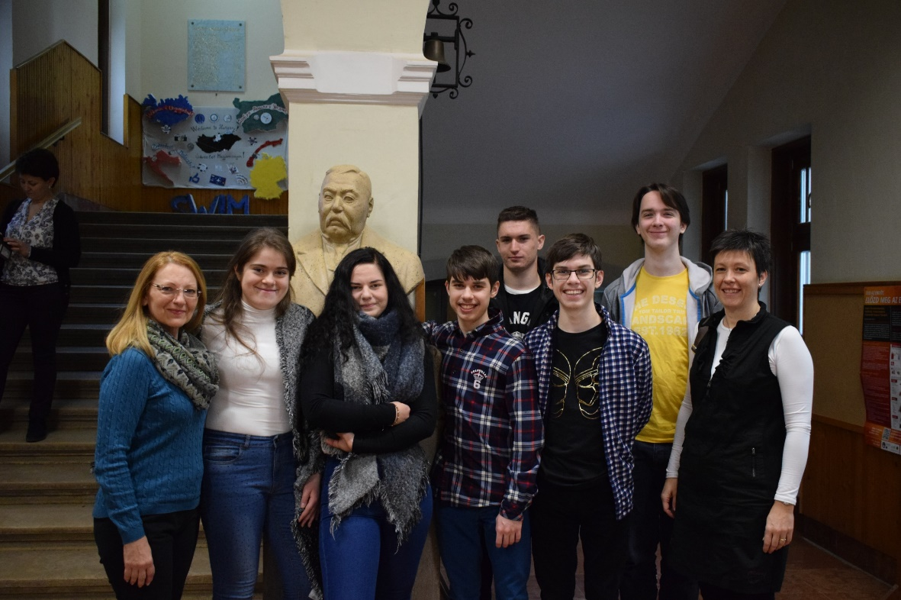
June
Monday | Tuesday | Wednesday | Thursday | Friday | Saturday | Sunday
27 | 28 | 29 | 30 | 31 | 1 | 2
3 | 4 | 5 | 6 | 7 | 8 | 9
10 | 11 | 12 | 13 | 14 | 15 | 16
17 | 18 | 19 | 20 | 21 | 22 | 23
24 | 25 | 26 | 27 | 28 | 29 | 30

Slide 8
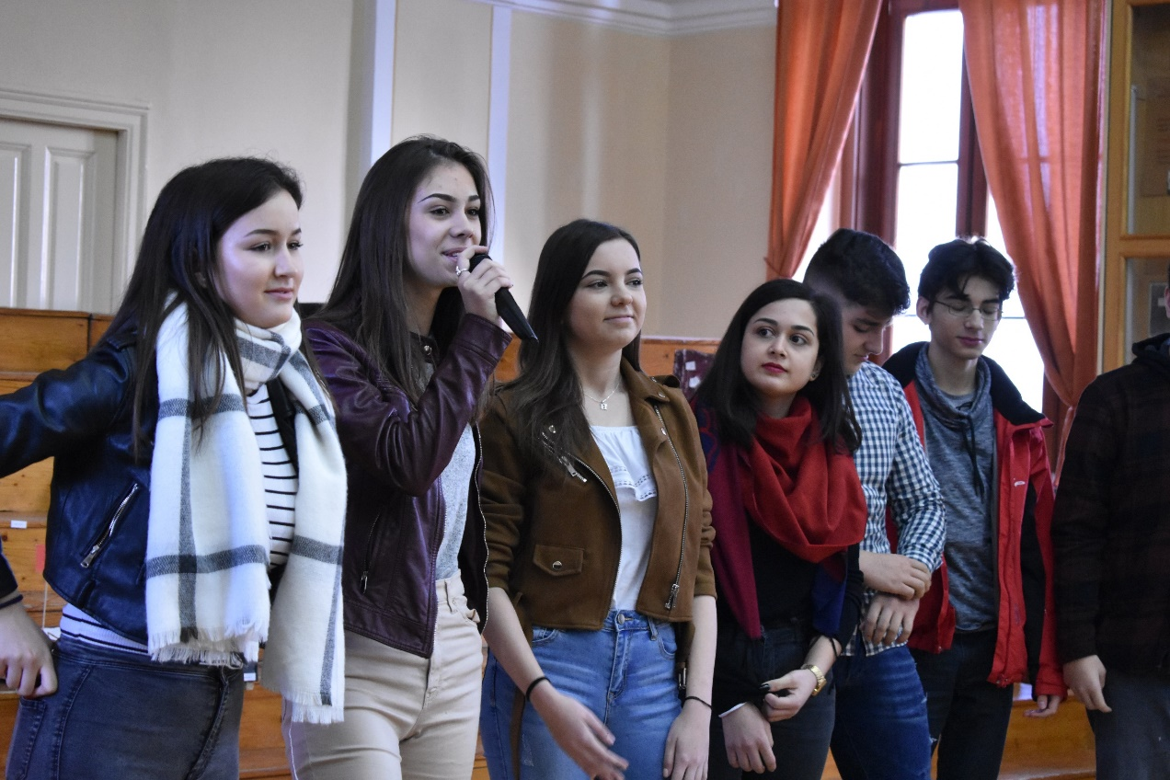
July
Monday | Tuesday | Wednesday | Thursday | Friday | Saturday | Sunday
1 | 2 | 3 | 4 | 5 | 6 | 7
8 | 9 | 10 | 11 | 12 | 13 | 14
15 | 16 | 17 | 18 | 19 | 20 | 21
22 | 23 | 24 | 25 | 26 | 27 | 28
29 | 30 | 31 | 1 | 2 | 3 | 4

Slide 9
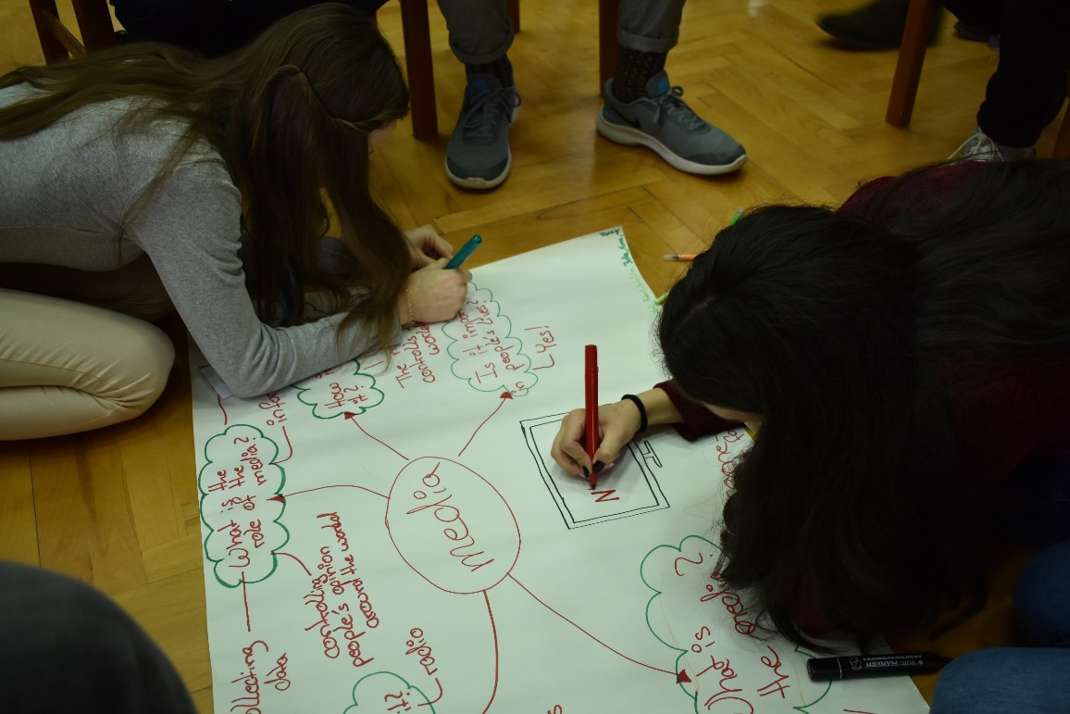
August
Monday | Tuesday | Wednesday | Thursday | Friday | Saturday | Sunday
29 | 30 | 31 | 1 | 2 | 3 | 4
5 | 6 | 7 | 8 | 9 | 10 | 11
12 | 13 | 14 | 15 | 16 | 17 | 18
19 | 20 | 21 | 22 | 23 | 24 | 25
26 | 27 | 28 | 29 | 30 | 31 | 1

Slide 10
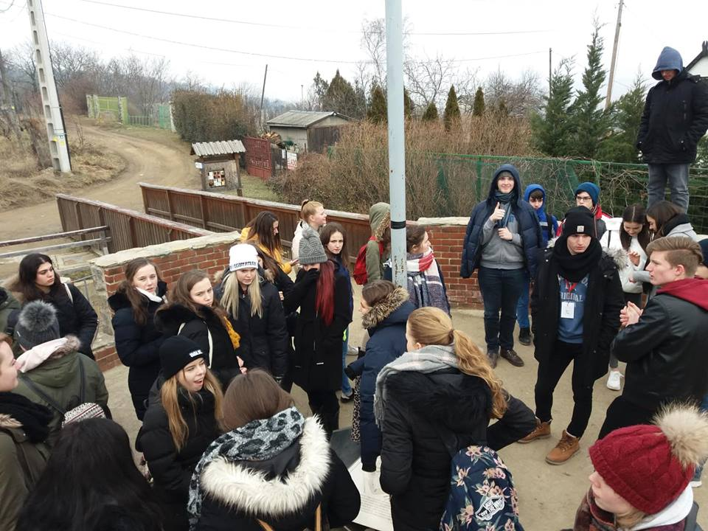
September
Monday | Tuesday | Wednesday | Thursday | Friday | Saturday | Sunday
26 | 27 | 28 | 29 | 30 | 31 | 1
2 | 3 | 4 | 5 | 6 | 7 | 8
9 | 10 | 11 | 12 | 13 | 14 | 15
16 | 17 | 18 | 19 | 20 | 21 | 22
23 | 24 | 25 | 26 | 27 | 28 | 29
30 | 1 | 2 | 3 | 4 | 5 | 6

Slide 11
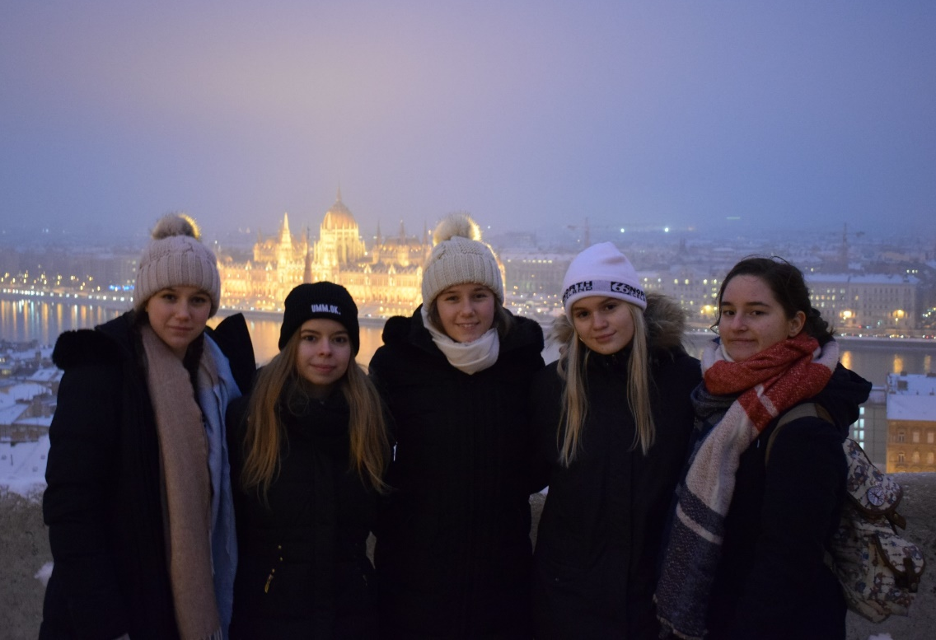
October
Monday | Tuesday | Wednesday | Thursday | Friday | Saturday | Sunday
30 | 1 | 2 | 3 | 4 | 5 | 6
7 | 8 | 9 | 10 | 11 | 12 | 13
14 | 15 | 16 | 17 | 18 | 19 | 20
21 | 22 | 23 | 24 | 25 | 26 | 27
28 | 29 | 30 | 31 | 1 | 2 | 3

Slide 12
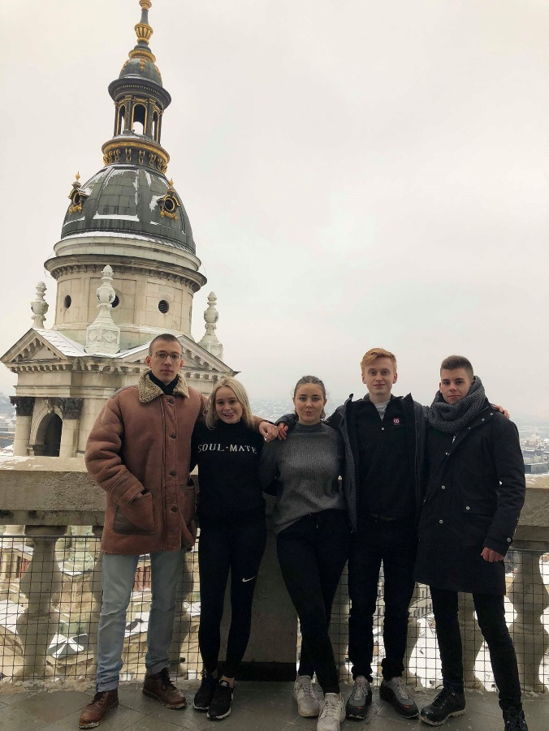
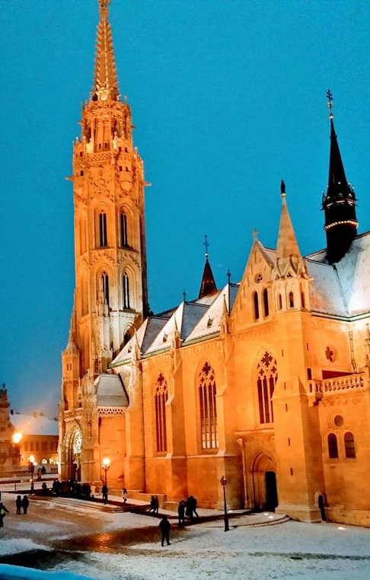
November
Monday | Tuesday | Wednesday | Thursday | Friday | Saturday | Sunday
28 | 29 | 30 | 31 | 1 | 2 | 3
4 | 5 | 6 | 7 | 8 | 9 | 10
11 | 12 | 13 | 14 | 15 | 16 | 17
18 | 19 | 20 | 21 | 22 | 23 | 24
25 | 26 | 27 | 28 | 29 | 30 | 1

Slide 13
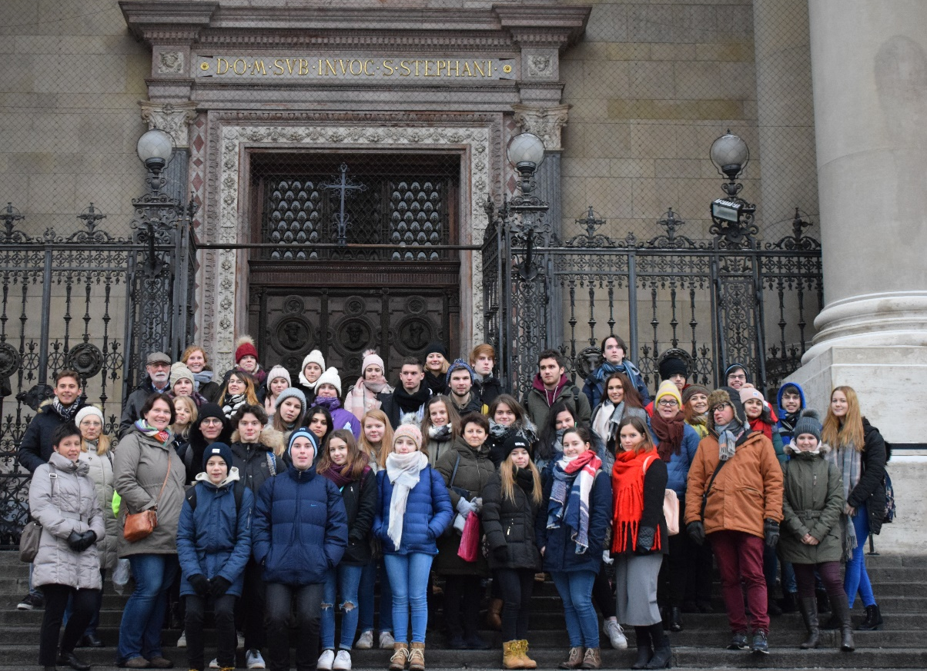
December
Monday | Tuesday | Wednesday | Thursday | Friday | Saturday | Sunday
25 | 26 | 27 | 28 | 29 | 30 | 1
2 | 3 | 4 | 5 | 6 | 7 | 8
9 | 10 | 11 | 12 | 13 | 14 | 15
16 | 17 | 18 | 19 | 20 | 21 | 22
23 | 24 | 25 | 26 | 27 | 28 | 29
30 | 31 | 1 | 2 | 3 | 4 | 5

